Slide 1

Rationale
Introduction to Windows Store App Development Using HTML5 and JavaScript
Computer science is a field of study that deals with solving a variety of problems by using computers.
  To solve a given problem by using computers, you need to design an algorithm for it.
Multiple algorithms can be designed to solve a particular problem.
An algorithm that provides the maximum efficiency should be used for solving the problem.
  The efficiency of an algorithm can be improved by using an appropriate data structure.
Data structures help in creating programs that are simple, reusable, and easy to maintain.
This module will enable a learner to select and implement an appropriate data structure and algorithm to solve a given programming problem.

Slide 2
Objectives
  In this session, you will learn to:
  Sort, filter, and group data
Notes:
2

Slide 3
Demo: Sorting, Filtering, and Grouping Data
  Problem Statement:
  Ryan successfully creates the Shopping portal app, which displays the details of various products manufactured by the company. Now, he wants to upgrade the functionality of the app. The upgraded version of the app will allow users to:
    Find the products by their type, such as Mobiles, Cameras, Laptops, Tablets, and Television Sets.
Notes:
3
Explain the parameters of the syntax.

Slide 4
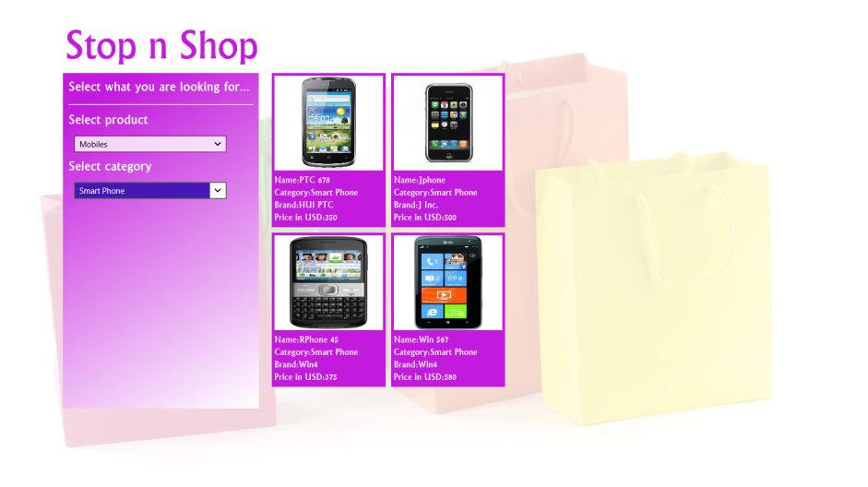
Demo: Sorting, Filtering, and Grouping Data (Contd.)
    Narrow down the search results by selecting the category of the selected product type, as shown in the following figure.
    In addition, the list of filtered products should be sorted based on their prices from low to high.
  Help Ryan to implement the preceding functionality in the app.
Notes:
4
Explain the parameters of the syntax.

Slide 5
Demo: Sorting, Filtering, and Grouping Data (Contd.)
  Solution:
  To enhance the preceding app, Ryan needs to perform the following tasks:
    1. Implement the functionality to select product by their type.
    2. Implement the functionality to select product category available in
    the selected product type.
    3. Execute the app and verify the output.
Notes:
5
Explain the parameters of the syntax.

Slide 6
Summary
  In this session, you learned that:
  To filter records, you can use the createFiltered() function of the WinJS.Binding.List object.
  To group records, you can use the createGrouped() function of the WinJS.Binding.List object.
Notes:
6

Slide 7

Q&A

